Slide 1

PDAS Ca2 What factors contribute to owning a car in Singapore? an analysis on Singapore Transport data
Justin wong juin hng (p2112646)

Slide 2
Objectives
In-depth walkthrough of the cleaning of given dataset(s)
Explain the purpose of dataset(s) analysis
Description of specific dataset(s) and related analyses
Analysis of insights gathered from dataset(s)
Credits

Slide 3
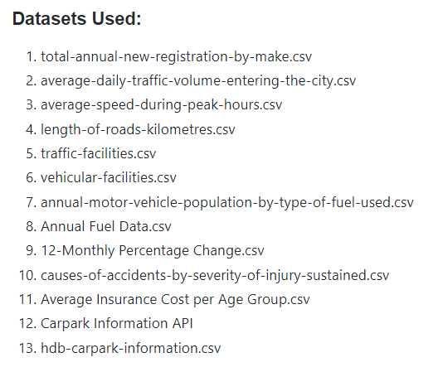
dataset(s) used

Slide 4
Objective of data analysis
As a potential car buyer in Singapore, I am looking at:
What are the most popular brand of cars sold and their respective models?
What road facilities am I provided with as a car buyer?
What are the most common accidents? If I get into an accident, what are the average vehicle insurance prices
How much are average fuel prices?
How congested is Singapore? How many cars are on the road and how fast can I drive?
After I’m done driving, where do I park my car?
1
2
3
4
5
6

Slide 5
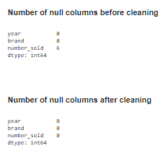
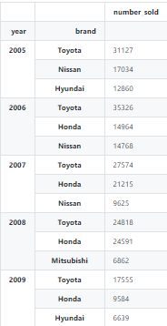
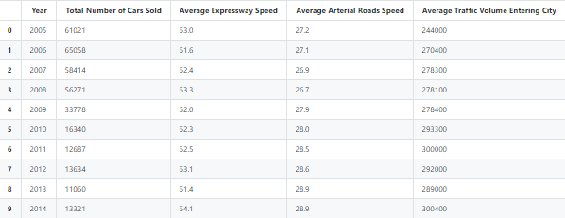
Data cleaning & Wrangling
Datasets: 1,2,3
Import
Import raw data from .CSV file
Clean
Assign names and labels
Declare
Declare arrays to store column-specific data
Store
Store column-specific data in arrays
Display
Display data for ease of viewing
Write
Write cleaned data to new .csv file for DAVI
df1 = pd.read_csv(r'./Datasets/(1) annual-new-registrations-of-cars-by-make/(1) total-annual-new-registration-by-make.csv') df1 = df1.rename(columns = {'make':'brand','number':'number_sold'}) display(df1.isna().sum()) df1 = df1.fillna(0) df2 = df1 df2 = df2.fillna(0) df3 = df2.groupby('year').head(3) df3 = df3.astype({"number_sold": int}) df3.to_csv('./Datasets/(1) cleaned.csv') display(df1.isna().sum())
display(df3.set_index(['year','brand'])) unique_values = df1['year'].unique() df4 = df3.reset_index() mean_values = [[i] for i in unique_values] i=0 for year in mean_values: mean_values[i].append(int(round(df4.loc[df4['year']==unique_values[i]]['number_sold'].sum()))) i = i+1 df5 = pd.DataFrame(data=mean_values,columns=['Year','Total Number of Cars Sold']) df6 = pd.read_csv(r'./Datasets/(2) road-traffic-conditions/(3) average-speed-during-peak-hours.csv’)
df7 = pd.read_csv(r'./Datasets/(2) road-traffic-conditions/(2) average-daily-traffic-volume-entering-the-city.csv’)
df7.to_csv('./Datasets/(2) cleaned.csv') df6.to_csv('./Datasets/(3) cleaned.csv') df6 = df6.rename(columns={'ave_speed_expressway':'Average Expressway Speed','ave_speed_arterial_roads':'Average Arterial Roads Speed','year':'Year'}) df7 = df7.rename(columns={'ave_daily_traffic_volume_entering_city':'Average Traffic Volume Entering City','year':'Year'}) df_list = [df5,df6,df7] df_final = reduce(lambda left,right: pd.merge(left,right,on='Year'), df_list) #merge data using lambda function df_final.to_csv('./Datasets/Cleaned Data/(1,2,3) cleaned.csv’)
display(df_final)
fillna(0) to fill null values with 0
set_index() to format for viewing
pd.DataFrame() to initialize DataFrame
reduce(lambda left,right: pd.merge(left,right,on='Year'), df_list) to merge datasets together
read_csv() & to_csv() to read the original data and write the cleaned data for DAVI visualization analysis

Slide 6

Explanation of insights
There were 6 empty columns in number sold, hence they were filled with a 0 value to ensure that the total number of brands were counted correctly. There were not filled with a string as ‘number_sold’ in an integer type, and it made the most sense to fill it in as such.
From 2005 to 2017, the most popular brand was Toyota. However, the third and second places are constantly changing, ranging from Nissan, Honda, Mazda and even luxury vehicles such as BMW and Mercedes.
From 2005 to 2017, even though the number of cars sold per year decreased, the average traffic volume entering the city increased. This suggests that car buyers in Singapore prefer to hold on to their vehicles as they retain their practical value.
In addition, average expressway and arterial road speeds increased by an average of 1.4km/h, suggesting that cars are driving at a faster speed due to greater availability of traffic facilities to reduce congestion e.g. more highways being built.

Slide 7
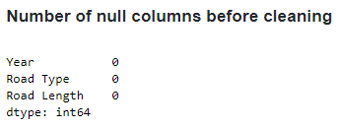
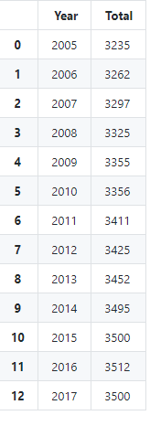
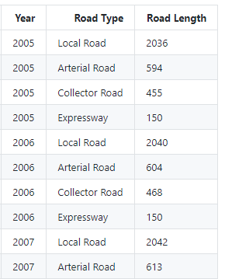
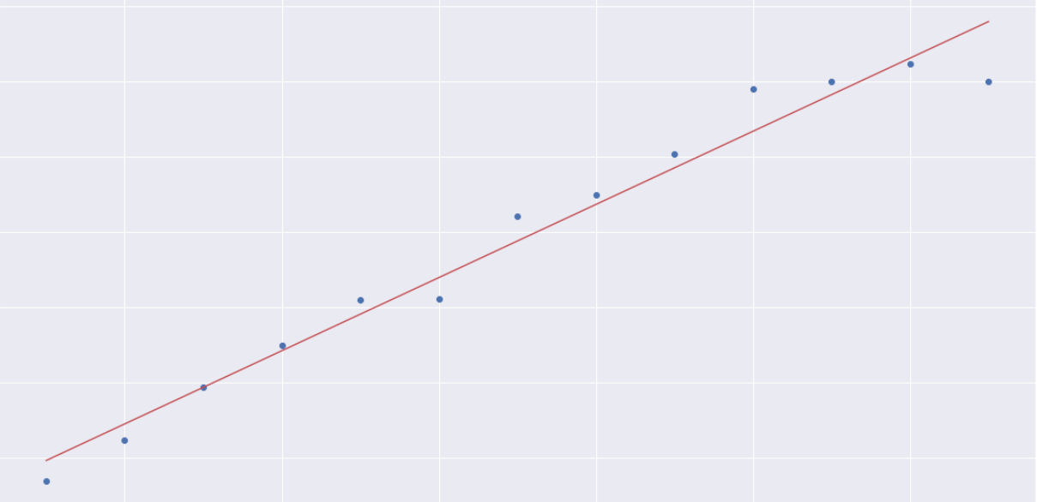
Data cleaning & Wrangling
Dataset: 4
Import
Import raw data from .CSV file
Clean
Assign names and labels
Declare
Declare arrays to store column-specific data
Store
Store column-specific data in arrays
Display
Display data for ease of viewing
Write
Write cleaned data to new .csv file for DAVI
total_road_length_keys = (np.unique(df8["Year"])) total_road_length_values =[] for year in np.unique(df8["Year"]): total_road_length_values.append(df8[df8["Year"]==year]["Road Length"].sum()) total_road_length = dict(zip(total_road_length_keys, total_road_length_values)) df8_total = pd.Series(data=total_road_length, index=np.unique(df8["Year"]))
df8 = df8.set_index(['Year','Road Type']) df8_total = df8_total.to_frame().reset_index() df8_total = df8_total.rename(columns={0:'Total','index':'Year'}) df8_total.to_csv('./Datasets/Cleaned Data/(4) total_cleaned.csv') display(df8_total) #check data fit stockModel = sm.OLS.from_formula("Total ~ Year", data=df8_total).fit() stockPredicts = stockModel.predict()
#print data analysis output print(stockModel.params) print(stockModel.summary()) x=df8_total['Year'] y=df8_total['Total'] plt.scatter(y=y, x=x)
# best fit line Y = C + M * X m,c = np.polyfit(x, y, deg=1) plt.plot(x, c+m*x, 'r-’) plt.xlabel('Year') plt.ylabel('Total') plt.show()
.isna().sum() to check for null values
np.unique(df8["Year"]) to retrieve unique years
dict(zip()) usage of dict() and zip() functions to create dictionary with road length values
df8_total.to_frame().reset_index() to create a DataFrame and reset its index
.rename(columns={0:'Total','index':'Year’}) to rename columns for ease of understanding
stockModel = sm.OLS.from_formula("Total ~ Year", data=df8_total).fit(), stockPredicts = stockModel.predict()
To check fit of data using linear regression
read_csv() & to_csv() to read the original data and write the cleaned data for DAVI visualization analysis

Slide 8

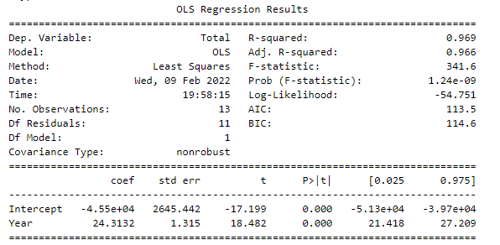
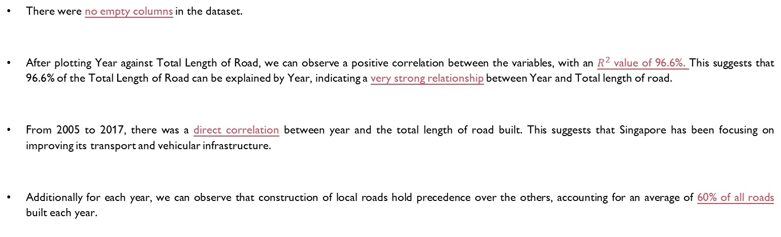
Explanation of insights
There were no empty columns in the dataset.
After plotting Year against Total Length of Road, we can observe a positive correlation between the variables, with an $R^{2}$ value of 96.6%. This suggests that 96.6% of the Total Length of Road can be explained by Year, indicating a very strong relationship between Year and Total length of road.
From 2005 to 2017, there was a direct correlation between year and the total length of road built. This suggests that Singapore has been focusing on improving its transport and vehicular infrastructure.
Additionally for each year, we can observe that construction of local roads hold precedence over the others, accounting for an average of 60% of all roads built each year.

Slide 9
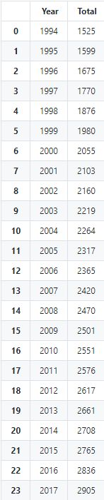
Data cleaning & Wrangling
Datasets: 5,6
Import
Import raw data from .CSV file
Clean
Assign names and labels
Declare
Declare arrays to store column-specific data
Store
Store column-specific data in arrays
Display
Display data for ease of viewing
Write
Write cleaned data to new .csv file for DAVI
df9 = pd.read_csv(r'./Datasets/(2) road-traffic-conditions/(5) traffic-facilities.csv') #import dataset 5 df10 = pd.read_csv(r'./Datasets/(2) road-traffic-conditions/(6) vehicular-facilities.csv') #import dataset 5 display(df9.isna().sum()) display(df10.isna().sum()) df9 = df9.rename(columns={'year':'Year','facility':'Type of Facility','number':'Count'}) #rename columns for easier readability df10 = df10.rename(columns={'year':'Year','facility':'Type of Facility','number':'Count'}) #rename columns for easier readability df_final = pd.concat([df9,df10]) #concatenate the 2 DataFrames for easier readability df_final = df_final.sort_values(by=['Year','Count']) df_final = df_final.reset_index() df_final = df_final.drop(columns=['index']) #clean final data display(df_final) total_typeof_keys = (np.unique(df_final["Year"])) total_typeof_values =[] for year in np.unique(df_final["Year"]): total_typeof_values.append(df_final[df_final["Year"]==year]["Count"].sum())
total_typeof = dict(zip(total_typeof_keys, total_typeof_values)) df_final_total = pd.Series(data=total_typeof, index=np.unique(df_final["Year"])) #make index using np.unique of years df_final = df_final.set_index(['Year','Type of Facility']) df_final_total = df_final_total.to_frame().reset_index() df_final_total = df_final_total.rename(columns={0:'Total','index':'Year'}) df_final.to_csv('./Datasets/Cleaned Data/(5,6) cleaned.csv') df_final_total.to_csv('./Datasets/Cleaned Data/(5,6) total_cleaned.csv') display(df_final_total) #check data fit stockModel = sm.OLS.from_formula("Total ~ Year", data=df_final_total).fit() stockPredicts = stockModel.predict() #print data analysis output print(stockModel.params) print(stockModel.summary()) x=df8_total['Year'] y=df8_total['Total'] plt.scatter(y=y, x=x) # best fit line Y = C + M * X m,c = np.polyfit(x, y, deg=1) plt.plot(x, c+m*x, 'r-') plt.xlabel('Year') plt.ylabel('Total') plt.show()
.isna().sum() to check for null values
np.unique(df8["Year"]) to retrieve unique years
pd.concat([df9,df10]) to join the datasets for easier readability and functionality
df8_total.to_frame().reset_index() to create a DataFrame and reset its index
dict(zip()) usage of dict() and zip() functions to create dictionary with road length values
.rename(columns={}) to rename columns for ease of understanding
stockModel = sm.OLS.from_formula("Total ~ Year", data=df8_total).fit(), stockPredicts = stockModel.predict()
To check fit of data using linear regression
display() to view the DataFrame, Linear Regression Model and Lineplot
read_csv() & to_csv() to read the original data and write the cleaned data for DAVI visualization analysis

Slide 10
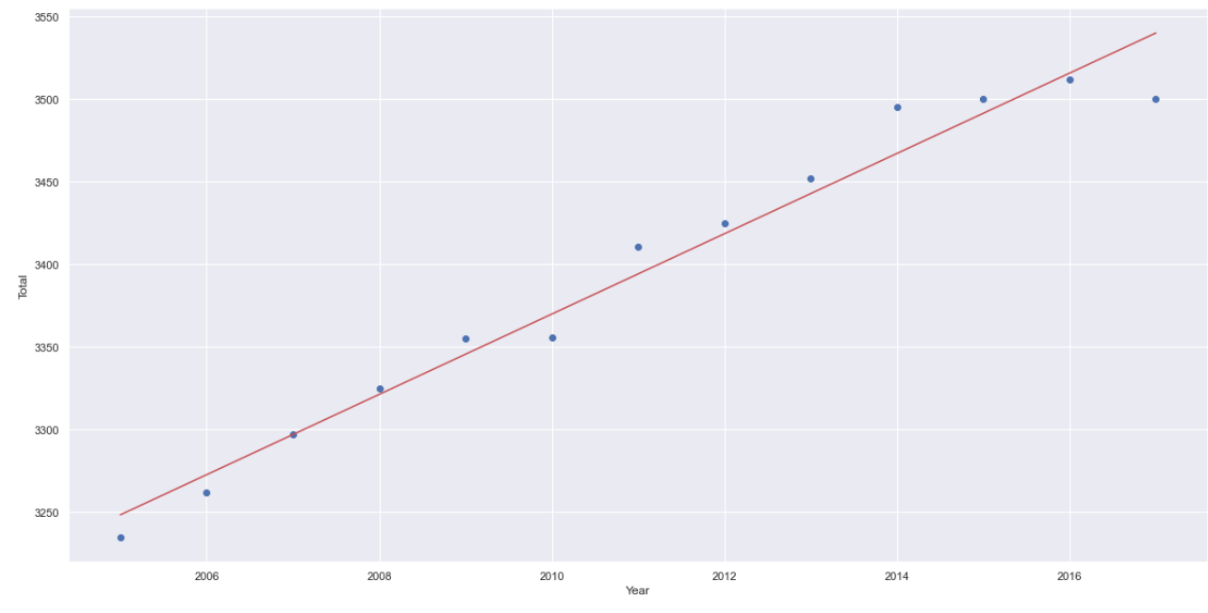
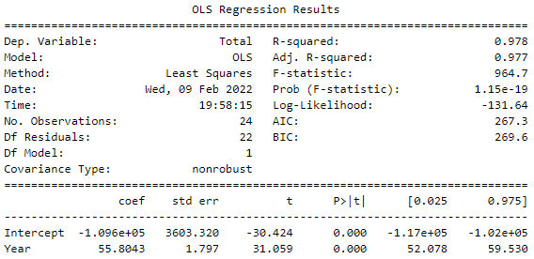
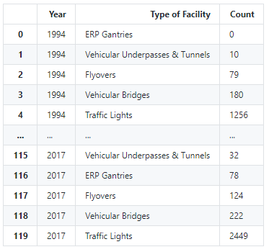
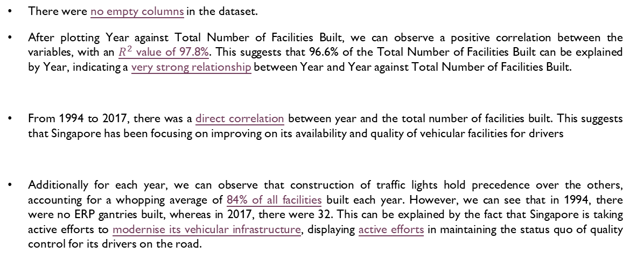
Explanation of insights
There were no empty columns in the dataset.
After plotting Year against Total Number of Facilities Built, we can observe a positive correlation between the variables, with an $R^{2}$ value of 97.8%. This suggests that 96.6% of the Total Number of Facilities Built can be explained by Year, indicating a very strong relationship between Year and Year against Total Number of Facilities Built.
From 1994 to 2017, there was a direct correlation between year and the total number of facilities built. This suggests that Singapore has been focusing on improving on its availability and quality of vehicular facilities for drivers
Additionally for each year, we can observe that construction of traffic lights hold precedence over the others, accounting for a whopping average of 84% of all facilities built each year. However, we can see that in 1994, there were no ERP gantries built, whereas in 2017, there were 32. This can be explained by the fact that Singapore is taking active efforts to modernise its vehicular infrastructure, displaying active efforts in maintaining the status quo of quality control for its drivers on the road.

Slide 11
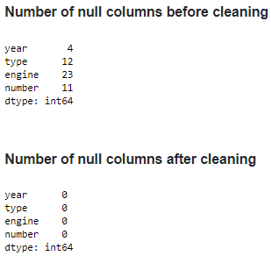
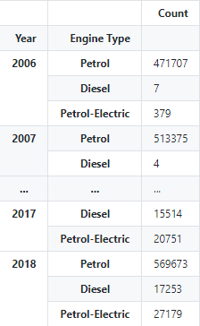
Data cleaning & Wrangling
Datasets: 7,8,9
Import
Import raw data from .CSV file
Clean
Assign names and labels
Declare
Declare arrays to store column-specific data
Store
Store column-specific data in arrays
Display
Display data for ease of viewing
Write
Write cleaned data to new .csv file for DAVI
df11 = pd.read_csv(r'./Datasets/(2) road-traffic-conditions/(7) annual-motor-vehicle-population-by-type-of-fuel-used.csv’) display(df11.isna().sum()) df11 = df11.dropna() df11 = df11.astype({"year": int}) df11 = df11.astype({"number": int}) display(df11.isna().sum()) df11 = df11.rename(columns={'year':'Year','engine':'Engine Type','number':'Count'}) df11 = df11.drop(df11[df11['type']!='Cars'].index) # only keep cars df11 = df11.groupby('Year').head(3) df11 = df11.drop(['type'], axis=1) df11 = df11.set_index(['Year','Engine Type']) df11.to_csv('./Datasets/Cleaned Data/(7) cleaned.csv') display(df11) df17 = pd.read_csv(r'./Datasets/(3) Fuel Data/(8) Annual Fuel Data.csv') df19 = pd.read_csv(r'./Datasets/(3) Fuel Data/(8) Annual Fuel Data Monthly.csv') display(df17.isna().sum()) df17 = df17.dropna() df17 = df17.astype({"Year": int}) display(df17.isna().sum()) df17.to_csv('./Datasets/Cleaned Data/(8) cleaned.csv') df19.to_csv('./Datasets/Cleaned Data/(8) monthly cleaned.csv') display(df17) display(df19) lineplot1 = sns.lineplot(data=df19) lineplot1.set(xticklabels=[0,1975,1985,1995,2005,2015]) plt.show() df18 = pd.read_csv(r'./Datasets/(3) Fuel Data/(9) 12-Monthly Percentage Change.csv') df20 = pd.read_csv(r'./Datasets/(3) Fuel Data/(9) Monthly.csv') display(df18.isna().sum()) df18 = df18.dropna() df18 = df18.astype({"Year": int}) display(df17.isna().sum()) df18.to_csv('./Datasets/Cleaned Data/(9) cleaned.csv') df20.to_csv('./Datasets/Cleaned Data/(9) monthly cleaned.csv') display(df18) display(df20) lineplot2 = sns.lineplot(data=df20) lineplot2.set(xticklabels=[0,1975,1985,1995,2005,2015]) plt.show()
.isna().sum() to check for null values
np.unique(df8["Year"]) to retrieve unique years
pd.concat([df9,df10]) to join the datasets for easier readability and functionality
df8_total.to_frame().reset_index() to create a DataFrame and reset its index
dict(zip()) usage of dict() and zip() functions to create dictionary with road length values
.rename(columns={}) to rename columns for ease of understanding
display() to view the DataFrame, Linear Regression Model and Lineplot
read_csv() & to_csv() to read the original data and write the cleaned data for DAVI visualization analysis
stockModel = sm.OLS.from_formula("Total ~ Year", data=df8_total).fit(), stockPredicts = stockModel.predict()
To check fit of data using linear regression

Slide 12
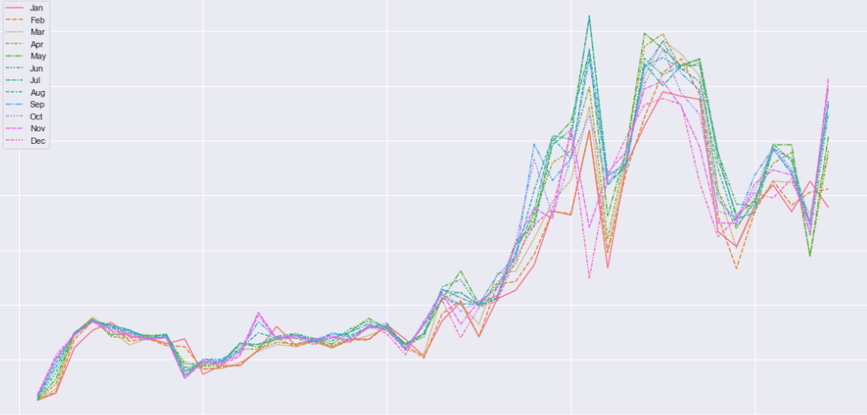
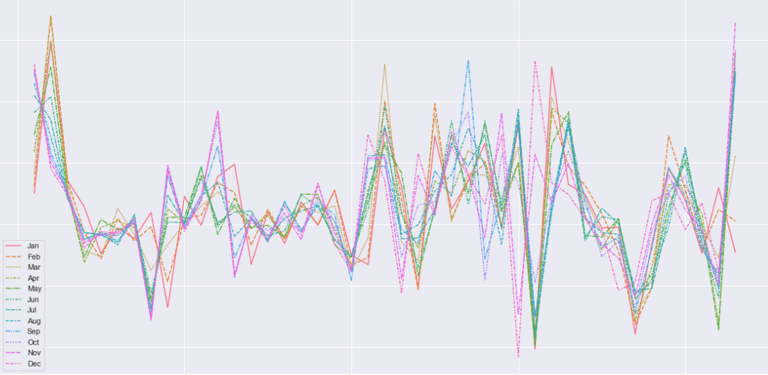
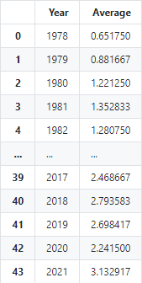
Explanation of insights
There were no empty columns in the dataset.
After plotting Year against Total Number of Facilities Built, we can observe a positive correlation between the variables, with an $R^{2}$ value of 97.8%. This suggests that 96.6% of the Total Number of Facilities Built can be explained by Year, indicating a very strong relationship between Year and Year against Total Number of Facilities Built.
From 1994 to 2017, there was a direct correlation between year and the total number of facilities built. This suggests that Singapore has been focusing on improving on its availability and quality of vehicular facilities for drivers
Additionally for each year, we can observe that construction of traffic lights hold precedence over the others, accounting for a whopping average of 84% of all facilities built each year. However, we can see that in 1994, there were no ERP gantries built, whereas in 2017, there were 32. This can be explained by the fact that Singapore is taking active efforts to modernise its vehicular infrastructure, displaying active efforts in maintaining the status quo of quality control for its drivers on the road.

Slide 13

Conclusion of insights
For housing properties within Singapore, consumers preferred:
- the North-Eastern and Central Region
to pay more for a preference in Region Choice
For housing properties within Singapore, prices were:
- more expensive the more rooms there were in the property
more expensive in the Central region and cheapest in the Northern Region
more fluid and unstable in Central regions and Eastern Regions due to greater flexibility in customisation options e.g. new estates (Punggol)
Housing properties within Singapore:
- were more expensive when it offered more comfort, resources and convenience
were more commonly found with 12-14 stories, and were built generally between 1965-2000
appreciated with time, due to a limited number of landsize available

Slide 14
credits
HOUSING A NATION, BUILDING A CITY (psd.gov.sg) [Accessed 2 Jan 2022]
gov.sg | Evolution of public housing in Singapore (www.gov.sg) [Accessed 2 Jan 2022]

